Slide 1
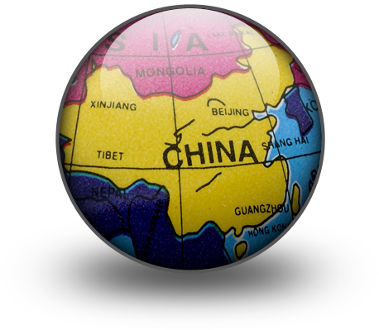
China Some intrestin fats
Back
Next

Slide 2
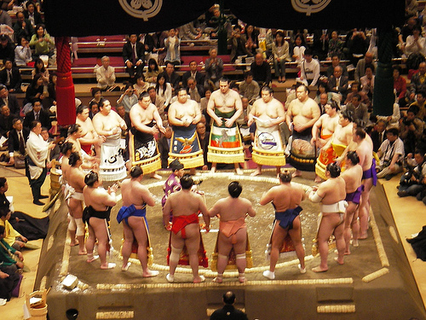
FACT 4
Sumo wrestling was invented in China
Back
Next

Slide 3

Fact 1
RICE
China is the worlds largest rice producer, and one of the earliest countries of rice agriculture. For thousands of years, the Chinese people have been diligently cultivating their land for big harvests.
The agricultural way of life, with rice as the centre, has played an important role in Chinas history. In the past, people held the belief that the precious things of life are the five grains with rice being number one, instead of pearls or jade. For the Chinese people, rice is the staple food in everyday meals.
Back
Next

Slide 4

Fact 2:
A world No.1 with: The world's longest manmade building—the Great Wall. The world's biggest ancient complex preserved today -- the Imperial Palace The world's largest square --Tian'anmen Square The world's oldest and longest human-made canal -- Grand Canal The world's widest and deepest canyon --The Yarlung Zangbo Grand Canyon The world's highest plateau -- Qinghai Tibet Plateau The world's most ancient tree species-- Maidenhair Tree The world's langue with the most users --Chinese The world's earliest and biggest cyclopedia—Yongle Canon The world's earliest book of tactics—Sun Zi's Military Strategy and Tactics The world's first collection of poems—The Book of Songs The world's biggest ancient series—Complete Collection in Four Treasuries The world's grand dictionary collecting most Chinese characters—Kangxi Dictionary The world's Buddhism grotto temple with the largest scale --Mogo Grottoes The world's eighth wonder-- Terracotta Warriors and Horses of Qin Shihuang's Mausoleum The world's highest preserved palace --Potala Palace The world's oldest wooden complex preserved today built on cliff --Overhanging Temple The world's biggest inland basin -- Tarim Basin One of the world's rarest animals --Giant Panda The world's No.
Back
Next

Slide 5
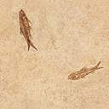
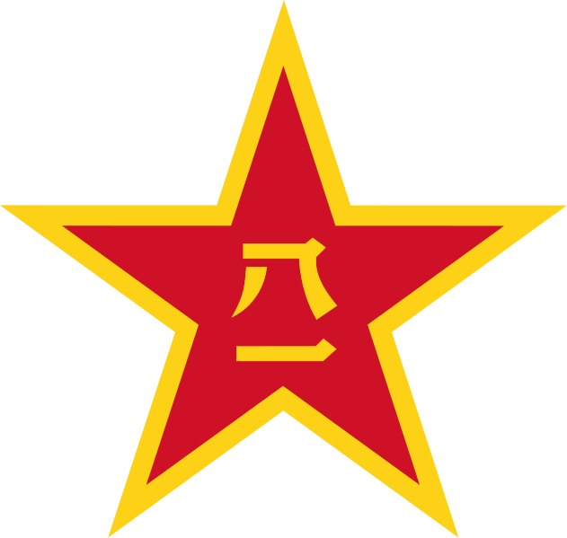
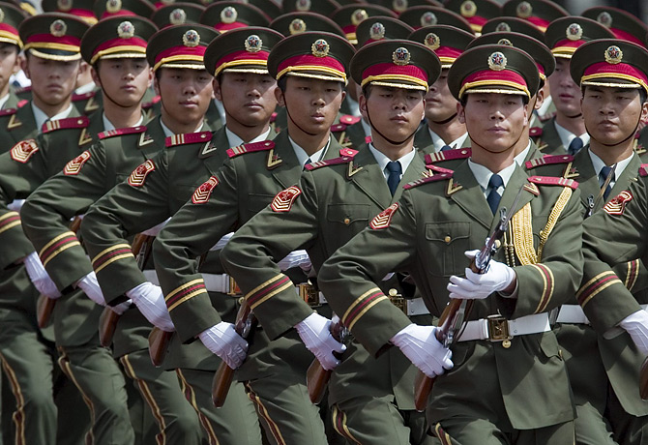
Fact 3
Largest Army in the World
Back
Next

